Slide 1
General awareness Functional Safety Training
GE Proprietary Information—Class III (Confidential)
Export Controlled—U.S. Government approval is required prior to export from the U.S., re-export from a third country, or release to a foreign national wherever located.​
Notes:
This is Functional Safety – SIL General awareness training.

Slide 2
Purpose -
IEC61511: Any person involve in the design, realization or validation of the Safety Instrumented System shall be competent in IEC61511.
Target audience – Any person involved in product and/or projects in GE Power.
After this training you will understand –
The term Functional safety and it’s significance
Basic concepts of functional safety GE Power Functional Safety process (High level)
Notes:
The Target audience for this training is any GE Power person involved in product and/or projects with Functional Safety – SIL scope.
After this training, you will understand –
The term Functional safety and it’s significance
Basic concepts of functional safety
GE Power Functional Safety process (High level)
Risks and opportunities with respect to functional safety

Slide 3
Agenda -
Introduction Safety and Functional Safety
Functional Safety Standards
What is SIL
SIL Process
Risk Analysis and SIL assignment (Targeting )
Design & design verification
Validation
Organization of Functional Safety in GE Power
Customer Deliverables
Notes:
Sections which will be covered by the training are –
Introduction to Safety and Functional Safety
Understanding of Functional Safety Standards
Explanation of What is SIL , SIL Process
Concept on Risk Analysis and SIL assignment (Targeting )
Definition & explanation on : Design & design verification
Validation of Safety functions.
Organization of Functional Safety in GE Power
& overview of functional safety Customer Deliverables

Slide 4
Introduction

Slide 5
Introduction – Safety & Functional Safety
Safety is a functionality of a technical product, such as
Production capacity (of whatever)
Efficiency
Emissions (or their absence)
and many others
Safety is subject of
Customer expectations
Contractual Requirements
Codes (Machinery Directive) and Standards
Permitting Procedures
Safety is . . .
made by the basic design of a product – in first instance
supported by specific assessment procedures
verified by a documentation of assessment and results
Notes:
This slide presents the definition of Safety & functional safety in general :
Safety can be defined as functionality of a product such as : Product capacity, Efficiency, Emissions. It can be defined as a subject of Customer expectations, Contractual requirements, Driven by codes & standards and by permitting procedures.
Safety is achieved or made by the basic design of a product , supported by defined assessment procedures & verified , validated by assessment & results.

Slide 6

Introduction – Safety & Functional Safety
Effective design rules
Good engineering practice
Engineering quality assurance
Safety Layers of
Technology
A
B
C
Proper design of interfaces
human ↔ equipment
D
Intrinsic risks of technical processes & equipment
Codes for dealing with specific risks, such as, e.g.
Explosions → ATEX
Fire → NFPA
Loss of pressure cont. → PED
Safety Functions protecting against disturbances →
Functional Safety
Notes:
This is graphic representation of different layers of Technology & intrinsic risks associated with equipment & personnel safety. Each layers shows the risks & it’s impact on engineering process, equipment & personnel. For ex: Good Engineering practices & design rules , Codes & Standards driven by regulations, & the most stringent safety functions protecting against disturbances – Functional Safety.

Slide 7
Introduction – Safety & Functional Safety
Risk Mitigation by Product Design
Three steps – by priority – mandatory priority, top down: Machinery Directive 2006/42/EC, Annex 1, clause 1.1.2; Principles of safety integration, item (b)
Inherently safe design – process or mechanical design
Necessary protective measures in relation to risks that cannot be eliminated
Information of users
Protective measures – typical embodiment: Safety Instrumented Functions
Functional Safety is : Engineering of Safety Instrumented Functions
Process control system
Safety system

Slide 8
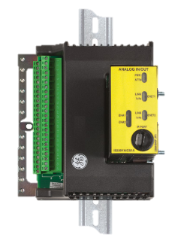
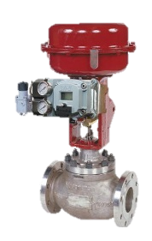
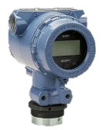
Safety Function & Risk Reduction
Severity
« Design systems to minimize dangerous failures and/or minimize their effects ».
Initial Risk
S₀
Severity reduction through physical means (design, barrier, Safety prevention plan…etc.)
Safety Instrumented Functions
Process regulation
(BPCS)
Residual Risk
Mechanical Prevention (Safety valves, rupture disc …etc.
Tolerable Risk Area
Sensors
Logic Solver
Final Elements
Residual Occurrence Frequency
F₀
Frequency
Notes:
Animated slide!!
Risk is described by the frequency and severity.
GE defines an tolerable risk criteria and if the risk is above this line it means that the design is not acceptable from a safety point of view.
Let’s start with a risk identified for example human hurt by a projectile due to a piping breach (overpressure).
For this risk we can identify several barriers as prevention plan, passive barrier such safety relief valve, control of the process.
By implementing Safety Instrumented Function, we are able to meet the tolerable risk. By definition a SIF is composed of sensors (to detect deviation), a safety controller and final elements.

Slide 9
Functional Safety Standards

Slide 10
Standards for Functional Safety
IEC 61508:
Generic, stand-alone, functional safety standard for
electrical/electronic/programmable electronic
safety-related systems
Provides the framework and core requirements for sector specific standards
Sets the standards for safety-related system design of hardware and software
First published in 1998
IEC 61508
(design of hardware & software)
IEC 62061
Ongoing effort to include low demand
Other functional safety standards
IEC 61511
(process)
IEC 61513
(nuclear)
IEC 62061
(manufacturing & machineries)
EN 13849:
Deterministic approach from EN 954-1
Qualitative approach based on IEC 61508
Stand-alone standard
Harmonized to the EU Machinery directive
USA standard is a mirror of IEC 61511
USA
ANSI/ISA 84.00.01
EN 13849
(safety related parts of control systems)
Notes:
There are various industry standards around Functional Safety. The application for these Industry standards varies on type of process or the industry represented. IEC 61508 is standalone FS standard for Electrical/electronic/programmable electronic safety related systems or another term – basic process control system. This standard was first published in 1998 & provides the hardware & software design requirements of Safety related systems.
IEC 61513 is the process industry standard for Nuclear applications.
IEC 62061 is the FS standard for manufacturing & machinery.
For GE Gas Power projects, our application falls under IEC 61511 for SIL execution. ANSI/ISA 84.00.01 mirrors IEC 61511, therefore, projects executed in USA with SIL requirements also follows IEC 61511. This approach is reviewed & validated by accredited 3rd parties for Functional safety.

Slide 11




Drivers for Functional Safety Compliance
Regulations
IEC 61511 Australia - GAS REGULATIONS 2012 - AS-NZS 5601 - AS 3814 - AS 61511
CFE Mexico -Federal Law referencing NRF-045-PEMEX-2010
Qualification as “State of the art”
SIL compliance defines benchmark of safe design (VGB, VDMA, UDT, Gasunie…)
Evaluated by local authorities for permitting
Legal litigations in case of accidents
Contractual obligation
Almost all petroleum companies requires SIL compliance
Algeria Mega deal
7EA Exxon Mobil
More requests for SIL certifications expected going forward
Notes:
Functional Safety compliance is mainly driven by the following points :
By regulations : For example, In Australia, as per Local Gas regulations act of 2012, all Power plant installations shall be SIL certified as per IEC 61511. Similarly, there are other regions in the world slowly evolving with new regulations around functional Safety.
Second driver for FS compliance is : State of the art design. Compliance with SIL designs benchmark of Safe design considered by different standard institutions such as VGB, VDMA, UDT etc. These are evaluated by local authorities for permitting & supports organizations in legal litigations in case of accidents.
Which leads to our 3rd driver which is contractual obligations. With regulatory framework developing & changing around the world for functional safety, many customers are asking for SIL compliance on contracts. Based on experience, we have noticed almost all petroleum companies requires SIL compliance. There are many end customers like Exxon mobil, KEPCO S Korea, Hyundai, Sonelgaz to name few, where almost every project requires the compliance with SIL.

Slide 12
What is SIL (Safety Integrity Level) ?

Slide 13
SIL – Safety Integrity Level
Discrete level (from 1 to 4) for specifying the required reliability of the safety instrumented function. Safety integrity level 4 has the highest level of safety integrity
Safety Integrity is attained by following measures –
Reliable system design (reliable components)
Reliable system architecture (redundancies)
Measures against systematic errors
SIL | On demand |  | Continuous
 | Probability of Failure on Demand (PFD_{avg}) | Targeted Risk Reduction Factor (1/PFDavg) | Dangerous Failure Per Hour (λ)
4 | 10⁻⁵< PFD_{avg} ≤ 10⁻⁴ | 10 000 to 100 000 | 10⁻⁹< λ ≤ 10⁻⁸
3 | 10⁻⁴< PFD_{avg} ≤ 10⁻³ | 1 000 to 10 000 | 10⁻⁸< λ ≤ 10⁻⁷
2 | 10⁻³< PFD_{avg} ≤ 10⁻² | 100 to 1 000 | 10⁻⁷< λ ≤ 10⁻⁶
1 | 10⁻²< PFD_{avg} ≤ 10⁻¹ | 10 to 100 | 10⁻⁶< λ ≤ 10⁻⁵
R’qmt Stringency
Equipment availability
Process risk
Notes:
SIL is an acronym for Safety Integrity Level. It is a discrete level (from 1 to 4) that specifies the required reliability of the safety instrumented function.
Safety Integrity is reached by following measures:
- Reliable system design (reliable components)
- Reliable system architecture (redundancies)
- Measures taken against systematic errors (for example human error)
As an example, SIL2 means the Safety Instrumented Function reduces the risk by a factor between 100 and 1000, and has a Probability of Failure on Demand (or PFD) comprised between 10⁻² and 10^{-3.}
Also, the higher the SIL, the more redundancies you may have to introduce in the design.
Be careful, focusing on reliability of the safety function could increase the spurious trip rate, thus decreasing the availability of the unit.

Slide 14
SIL Process

Slide 15
Safety Management Life Cycle (IEC 61511)
Management of the functional safety (roles & responsibilities),
Life cycle
Risk analysis
Verifications & audits
Allocation of safety functions and layers of protection
SIF Specification
SIS Specification
Specification of the other risk reduction systems
Conception/realisation of the other risk reduction systems
SIS Conception/realisation
Installation, commissioning & validation of SIS and the other risk reduction systems
Exploitation & Maintenance
Modifications
Decommissioning
Notes:
This standard addresses the complete functional safety lifecycle from ITO to the decommissioning of the product/plant.
This lifecycle consists in the following steps:
1. Safety analysis (definition of CTQs for Safety Instrumented Function design)
2. Design of the Safety Instrumented Function (conception and realization)
3. Installation, validation that safety functions are in place and functional
4. Operation of unit and maintenance of the SIF to maintain integrity of Safety Instrumented Function
5. Modifications brought during the life of the machine (applicable to CM&U)
During this step, any modification must be analyzed to evaluate the impact on Safety and the Safety Instrumented Functions
6. Decommissioning (when and how a Safety Instrumented Function shall be decommissioned)
In parallel the standard requires the whole functional safety lifecycle is covered by verification steps and audits, and a full management process is in place.

Slide 16
Risk analysis & SIL assignment (Targeting)

Slide 17
Risk Analysis Process
Scope and System Design Definition
Certification Scope
Preliminary Hazard Assessment
PHA : Identifies potential installation, operation, and maintenance hazards over a wide range of pre-defined hazard categories.
Safety Manual
(customer deliverable)
Hazardous Operation
HazOp : Identifies Effects of an initiating single point failure. This helps mitigate the likelihood of the occurrence of the initiating event in a credible accident scenario.
Accident Scenario Review
ASR : Numerical tool that allows the review team to model the high risk accident scenarios stemming from the HazOp. Total residual risk must meet GE full life requirement.
SIFs and their SIL targets
Technical Requirements
to SIFs
Notes:
This section shows the relationship between safety process and the standard.
First, we define the applicable scope of the project.
The safety process consists in 4 main steps:
scope definition
Preliminary Hazard Assessment
HAZOP
and Accident Scenario Review.
The results of this last step will define the list of Safety Instrumented Functions applicable to the scope and the associated Safety Integrity Level targets and specific safety requirements.

Slide 18
Risk Analysis Process
Working team :
Design
Controls
System Engineer(s)
Product Safety Engineer
If applicable, additional members can include :
GE Services
Field Engineers
Environment Health and Safety (EHS)
Manufacturing
Risk Analysis documents of products are GE internal & proprietary. Customer gets specific output only: SIF list and Safety Manual.
Notes:
The risk analysis process requires the involvment of design, controls, systems and product safety teams, with the support of other disciplines when needed such as field teams, EHS or manufacturing.
The complete study is GE proprietary data, but the end user will get the list of Safety Instrumented Functions included in the Safety Manual.

Slide 19
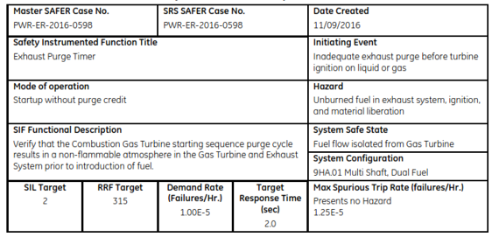
Safety Requirements Specification
Record SIFs and SIL Targets
Define Safety Integrity Requirements
Definition of Demand Mode & Demand rate
SIL Target
Risk Reduction factor or PFH value
Response Time
Notes:
The definition of the Safety Instrumented Functions and their SIL target are recorded in Safety Requirements Specifications issued by Product Safety. This document includes a SIF description, its mode of operation, the safe state of the considered equipment, the Risk Reduction Factor or Probability of Failure targets and the maximum response time of the SIF.
This document doesn’t contain the information on the SIF design.
Warning! “SRS” has a different meaning in the IEC61511 standard (it includes design, validation steps…)

Slide 20
Technical Requirements to SIFs
Documented in
SRS ( Only high level items )
Design Practices
Specific Design calculations & considerations
Safe State – State of the machine or process to be attained in case of malfunction
Trigger conditions – Process measurement & critical value which indicate that the process is in risk and SIF must be executed
Response Time – Time window for reaching the safe state after trigger conditions have been detected
Technical boundary conditions of machine or processes – For ex: process parameters like pressure temperatures or standards for mechanical communication interfaces etc.
Testing Conditions – Allowance from the side of the machine or process for testing SIF or components of SIFs
Notes:
Among the technical requirements to be included in the design of the SIF, we have:
- The Safe State, which is the State of the machine or process to be attained in case of malfunction
- The Trigger conditions, which are Process measurements & critical values which indicate that the process is in risk and protective action must be initiated (which is typically a process shutdown)
- Response Time , the Time window for reaching the safe state after trigger conditions have been detected
- Technical boundary conditions of machine or processes – For ex: process parameters like pressure temperatures or standards for mechanical communication interfaces, etc.
- Testing Conditions, which specify allowance from the side of the machine or process for testing SIF or components of the SIFs

Slide 21
Design & Design verification

Slide 22
Safety Design Principles
Reduction of probability of failure
Structural simplicity
Redundancy
Measures against systematic errors
Use of high quality components and materials
Segregation of safety systems from normal operational equipment
Example : Safety Controller
Safety sensors
Safety controller MarkVIeS
Unidirectional communication
Actuators
Process sensors
Process
Controller MarkVIe
Yellow - SIL
SIL independence principle
Notes:
To reach the safety requirements, there are several principles to be considered during the design of the Safety Instrumented Functions, such as:
The reduction of probability of failure of the protective system, through the choice of a simple structure, adequate redundancy of components, proper measures against systematic errors (for example to prevent human error), and use of high quality components and materials ;
The proper segregation between the safety system and the basic process control, which is required by the standard: for example, there is a separate safety controller (MarkVIeS) in addition to the basic procees controller MarkVIe, and the basic process cannot influence the safety system in any way.

Slide 23
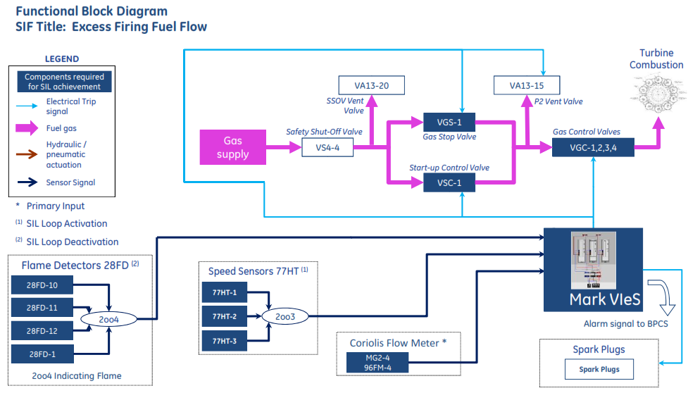
Functional Block Diagram (FBD)
FBD shows the components and architecture of related SIF

Slide 24
Verification requirements
Structure of safety function
Segregation
Redundancy
Qualifications for SIF components complete
Calculated reliability
Input for controls specified & controls logic tested
Testing scheme defined
Testing documents prepared for operation
Notes:
The design is reviewed and validated to make sure the main requirements have been incorporated, such as:
Proper segregation of process control and protection
Minimum redundancy
Reliability and response time
Safety controller application software is verified by a systematic test during a dedicated Software Acceptance Test.
During this phase, testing and maintenance requirements are also checked.

Slide 25
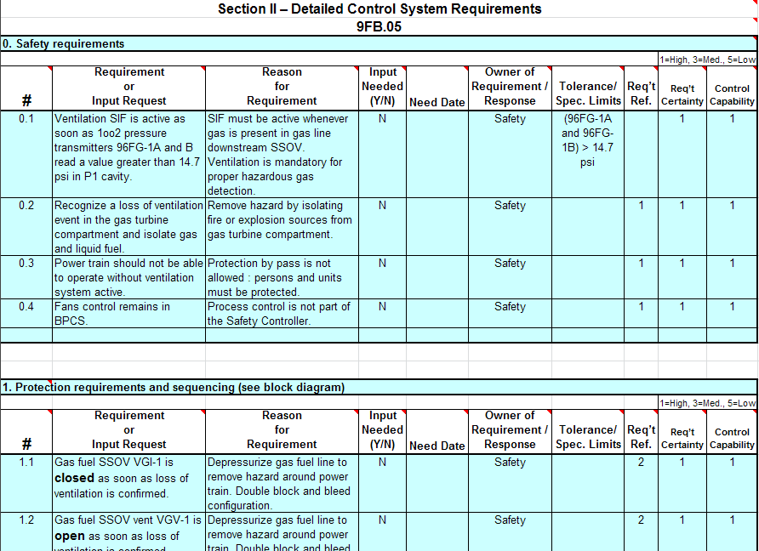
For Ex: Controls Requirement Specification
Synthesizes all requirements for software and hardware development
Provides data for coding and designing the panel
Starting point for the Controls Design Standard
Created by the Controls team based on inputs from the SRS, FBD, and SDS
SRS
(Product Safety)
FBD
(Systems Reliability)
SDS
(Design)

Slide 26

Factory / Software Acceptance Tests (FAT/SWAT)
Key element of compliance verification, per IEC 61511
Validate the MarkVIeS, including I/O configuration
Typically only needed for Fleet Leaders and major changes
For most GE Power products, baseline FATs are already complete. For each project, evaluate if the baseline applies. If not, additional cost and cycle must be added to the project for Factory Acceptance Testing.
May be witnessed by the Third Party
Notes:
One of the critical steps of IEC61511 verification steps is hardware & software design of the safety controller.
This phase ensures:
The hardware configuration includes all necessary inputs/outputs, with the required redundancy ;
The software is designed according to IEC 61511 requirements, including diagnostics & fault monitoring.
Those validations steps are required by the standard and may be witnessed by third parties, for 61511 certification or for other regulatory requirements (such as European Directives).

Slide 27
Validation

Slide 28
Validation
Demonstration that safety functions are in place & functional on site.
Notes:
Next step is the installation and commissioning of the Safety Instrumented System on site. During this step GE must demonstrate it is properly installed and all Safety Instrumented Functions perform as intended.

Slide 29

Site Acceptance Tests
The SAT validates the installed Safety Instrumented System during commissioning the each unit.
3 types of tests:
Sensor Loop Checks – validate the correct sensor wiring and proper generation of sensor fault alarms
Final Element Loop Checks – validate correct wiring by verifying the safety controlled can trip each final element
Functional Tests
Before First Fire:
Calibration of Coriolis, GT compartment air flow sensors and Hazgas sensors
Validation of speed sensors and flame detectors
Response time of final elements
E-stop test
Ignition fault test
After First Fire:
Overspeed test
+ Potential for additional tests based on Third Party requirements
Notes:
To validate the SIS, we perform a Site Acceptance Tests validation which typically includes 3 types of tests:
Sensors loop checks to validate the sensors are correctly wired to the safety controller and proper signals are generated ;
Final elements loop checks, to validate the final elements (e.g. valves) are correctly wired to the safety controller and are properly actuated when needed ;
And some functional tests, to demonstrate the proper integration of all sub-systems, such as for a gas turbine:
Calibration check of transmitters, validation of SIS devices
Measurement of critical response times of devices
Emergency stop test
Ignition fault test before firing the unit
After first fire, demonstrate the overspeed protection is operational.
Depending on the project requirements, some additional testing may be needed ; in addition, some tests may be witnessed by third parties.
Similar testing is applied on steam turbines (before & after first roll) and on Water Steam Cycle.

Slide 30
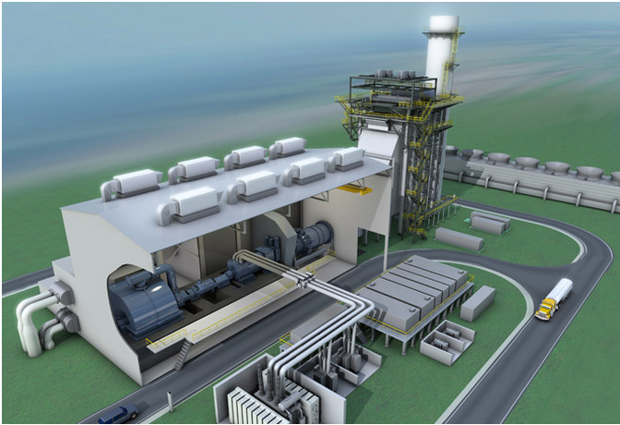
Installation/Commissioning
SATs are performed by a Field Engineer with specific training relative to IEC 61511 compliance
The engineer performs the SATs before and after the unit start-up and identifies the serial numbers of each component in a SIL safety loop, per the SAT Specification for traceability. A successful SAT is required before the unit is released for start-up for the first time.
The Third Party may witness the SATs on site
Notes:
GE works with site field engineers to complete the relevant tests as defined by GE SIL tests procedures. This is applicable to GE scope of supply, including gas turbines, steam turbines, Heat Recovery Steam Generators, Water Steam Cycle, and Balance of Plant.
Those field engineers must be trained specifically to understand the requirements of functional safety during installation and commissioning, through a specific training.
In liaison with GE SIL Compliance team, the field engineers perform the Site Acceptance Tests, record results for validation by engineering, and correct any identified issues. All tests results are recorded and validated by the SIL Compliance team.
When working with a third party, witnessing of the tests may be required.

Slide 31
Organization of Functional Safety in GE Gas Power

Slide 32
Roles and Responsibilities
SIL Compliance Leader
- Coordinates all activities related to SIL
- Creates the Proof test procedures
- Works with 3rd party to gain certification
- Performs SIL targeting, and creates the SIF/SIS functional safety requirements
- Communicates needs and opportunities for functional safety improvement within the installed fleet
Product Safety Engineer
- Owns the SIF/SIS SIL assessment and creation of documentation for the customer safety manual
- Communicates safety requirements to applicable design/controls engineers
Systems Reliability Engineer
- Ensures equipment under their ownership meets SIL target requirements through technical reviews and applicable change control
Design Engineer
Controls Engineer
- Develops the safety controller system (includes software, hardware, and firmware)
- Specifies requirements, creates SAT specifications and performs SWAT for safety controller
Field Engineer
- Performs the validation tests of the SIFs
- Transmits & records the tests results
- Communicates the need to conform to IEC 61511 and schedules SIL activities to meet customer contract requirements
- Approves all design changes impacting safety functions/systems
- Assembles and distributes the customer safety manual
Project/ Requisition Engineer
Controlled Title
Holder
- Verifies that the design meets the requirements by ensuring adequate reviews have been held
- Approves the final ASR and functional safety documentation in a secured database

Slide 33
Roles and Responsibilities
SIL Compliance Leader
Coordinates all activities related to SIL
Creates the Proof test procedures
Works with 3rd party to gain certification
Controls Engineer
Develops the safety controller system (includes software, hardware, and firmware)
Specifies requirements, creates SAT specifications and performs SWAT for safety controller
Product Safety Engineer
Performs SIL targeting, and creates the SIF/SIS functional safety requirements
Communicates needs and opportunities for functional safety improvement within the installed fleet
Project/ Requisition Engineer
Communicates the contractual functional safety requirements and schedules SIL activities
Approves all design changes impacting safety functions/systems
Assembles and distributes the customer safety manual
Systems Reliability Engineer
Owns the SIF/SIS SIL assessment and creation of documentation for the customer safety manual
Communicates safety requirements to applicable design/controls engineers
Controlled Title Holder
Verifies that the design meets the requirements by ensuring adequate reviews have been held
Approves the final ASR and functional safety documentation in a secured database
Design Engineers & Item
Owners
Participate to Risk analysis, propose design and component test, inform any modification on SIS
Controls Field Engineer
Verifies all tools needed for Site Acceptance Tests are available, calibrated and certificates are available
Conducts Site Acceptance Tests, and provides results to the SIL Compliance Leader
Notes:
IEC61511 requires independence throughout the different phases of the functional safety lifecycle. GE maintains this independence by defining roles within the company based on design and functional responsibilities.
The main stakeholders on any functional safety project are SIL Compliance team, Product Safety organization, Design Engineering, Controls Engineering and Field Engineering. SIL Compliance team ensures that all the stakeholders involved in any functional safety project have received the adequate training as per their functions defined in EED-400.
Throughout the project lifecycle, the stakeholders work with Project/Requisition Engineers to drive the project schedules & commitments as needed. The SIL execution team works under the technical guidance of Controlled Title Holders.

Slide 34
Safety Management Life Cycle
IEC 61511 compliance management (compliance leader)
Team and planning definition and follow up
Scope of supply (Global Functional Block diagram)
Safety integrated functions and related SIL targets
Safety Requirements Specification
SIL Targeting
(Safety)
SIS design
& Reliability assessment
SIS Functional Block Diagrams
SIL verification SIL(a), Reliability Block Diagrams
Component requirements documentation
SIS description
Maintenance requirements
Proof tests spec, FATs
CRS, diagrams, ratio table, code
Design update
N
SIL(a)> SIL
Y
Installation, commissioning SIL validation (Field)
Planning
Safety controller software simulation
Installation quality document
Validation test results
Corrective actions
N
Validation
Y
IEC 61511 Certificate
Safety manual
Certification
(3rd party)

Slide 35
SIL compliance leader Missions–within baseline
From project kick-off up to final O&MM delivery, manage the IEC61511 compliance and certification
Interaction with 3rd Party (EXIDA or INERIS)
SIL Certificate
Project information- quotation request
Customer
3 Months
SAT Spec and cert file prelim
2 Months
Certif File
Safety Manual
Safety Manual prelim
1 Month
1 to 2 Months
project KoM
Pre Installation Meeting
AE Support
FIRST FIRE
SATs
2 weeks
PLM
Option verification according to contract
Assumption review with control
Commissioning plan to include SAT
SIL KoM
SAT Dashboard
RFR Portal-GE Folders
Ta control coordination for SAT and results
Green light in RFR
Dashboard: it freezes input data for control
1. Dashboard and actions list
Document delivery (mainly linked to customer requests: kks, specific design with no impact on reliability calculation
Notes:
Exemple de bilan sur Mittelsbueren

Slide 36
Customer Deliverables

Slide 37

Safety Manual
The Safety Manual is a customer deliverable compiled by the SIL Compliance Team. It provides the customer with all information for maintenance and future changes of the safety systems.
Safety precautions
Details of all SIFs
Safety Requirements Specification (SRS) Summary
SIF Summary
Functional Block Diagrams (FBDs)
Components Maintenance & Requirements Summary (CMRS)
Proof Tests with refurbishment/replacement requirements and procedures
Customer responsibilities
Safety Manual
Notes:
After full satisfactory site validation of the Safety Instrumented Systems, GE provides the necessary information for the end user to safely operate its power plant during its useful life, by properly maintaining its safety functions.
This is included in the Safety Manuals provided with the units. A typical Safety Manual includes:
Safety precautions to operate the unit
Description of the Safety Instrumented Functions
Maintenance requirements
Responsibilities for the end user to maintain the safety integrity of the SIS.

Slide 38
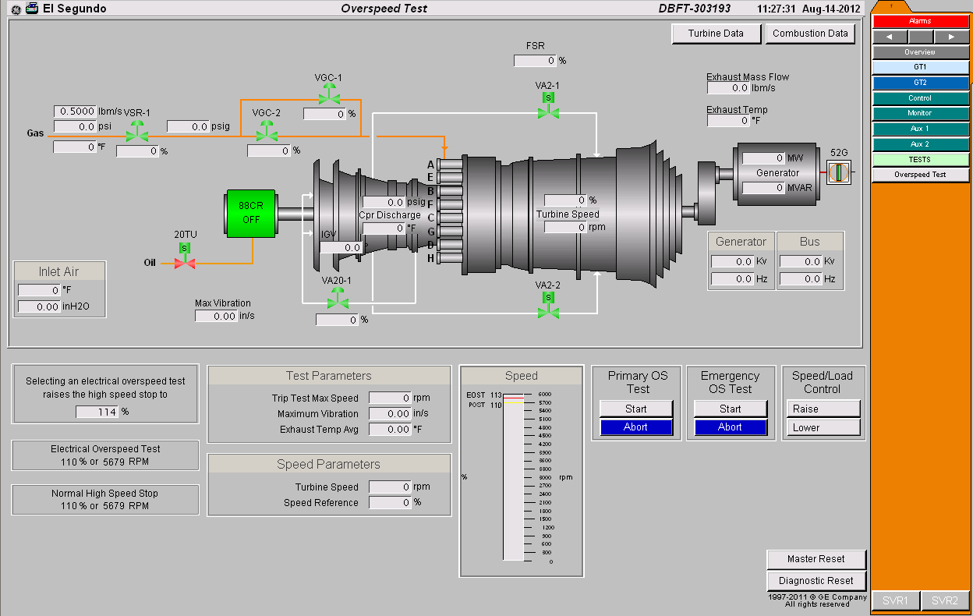
For Ex: Proof Test Procedure
Manual testing of safety system components to detect any failures not detected by automatic online diagnostics.
Definition of the procedure and frequency for proof testing of each component in the SIS
Troubleshooting instructions in case of unsuccessful proof test results

Slide 39
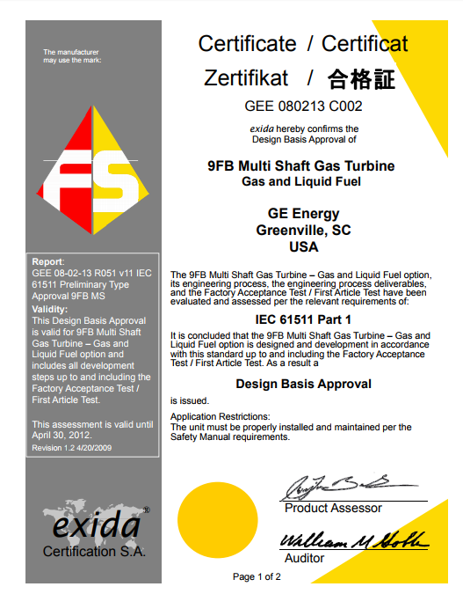
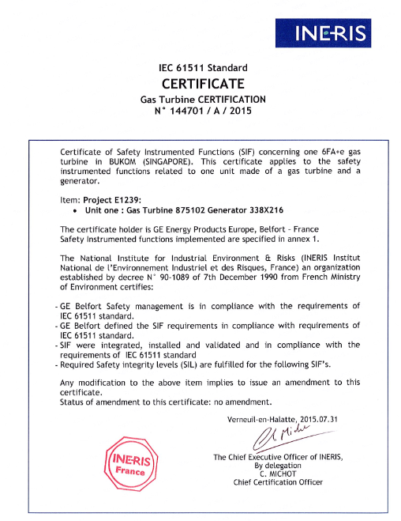

Third Party Certification
Confirmation of compliance with IEC 61511 by independent experts
Notes:
GE has been working with several third parties to demonstrate that the products and processes comply with IEC61511 requirements.
Depending on the legal or contractual requirements, GE may provide SIL certification to the end customer.

Slide 40
Takeaways

Slide 41
Takeaways
GE Gas Power plants follow IEC61511
Functional Safety is about safety integrity through structured & documented process up to site validation
Segregation of Protection & Process control
Functional Safety means thinking as a system & working as a cross-functional team
Verification & traceability are key requirements

Slide 42
References to GE Functional Safety QMS Procedures :
EED – 400 Management of Functional Safety (IEC 61511)
EED – 415 Safety Integrity Level Targeting & Assessment Instruction
GPTC – 7.0.1.25 SCL Work Instruction
GPTC – 7.0.1.38 Safety Integrity level verification work instruction
Notes:
Compliance with functional safety lifecycle requirements is covered in GE QMS by several procedures, which are available in Confluence.

Slide 43
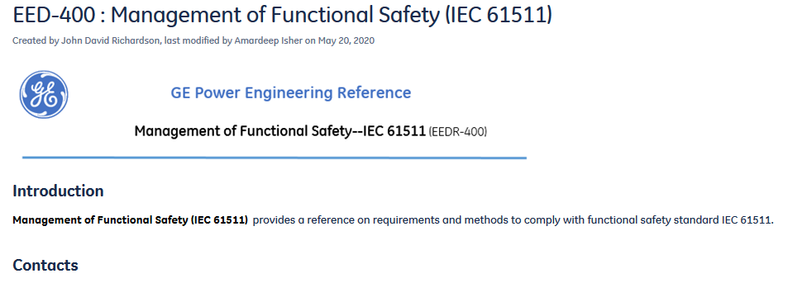
Contacts
For any further question on SIL Compliance, please reference EED-400 in Confluence, or contact SIL Compliance team.

